Slide 2
EVERFI:
Educación para el Aprendizaje del Mundo Real
09 de marzo 2023

Slide 3
Agenda
Introducción
Descripción general
Recursos de Instrucción
Empezando Con EVERFI
Preguntas y Respuestas

Slide 4
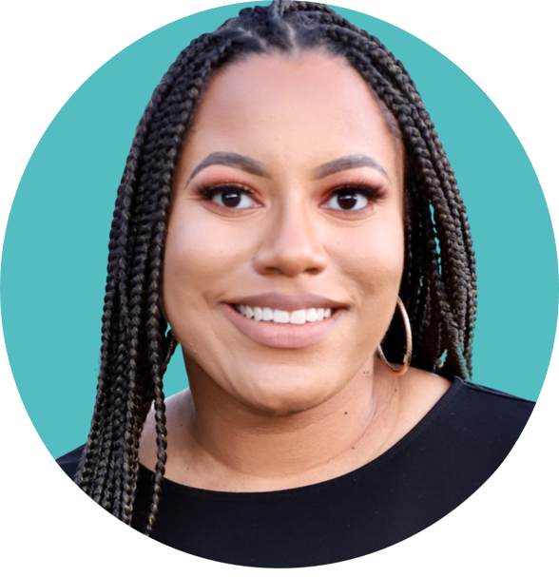
Diamond Anderson
K12 Implementation Specialist
North Florida and Georgia
I am originally from northern Virginia and was born into a family of educators!
I was an English teacher for 4 years and an instructional coach for 2 years.

Slide 5
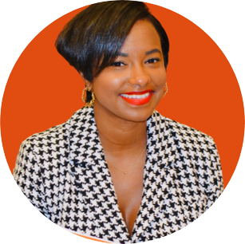
Khalia Murray
K12 Implementation Specialist
Georgia
Based in Atlanta, GA
Former Elementary Educator and Founder of Online Tutoring Services
Dedicated to helping Georgia educators get acclimated with using our digital courses to aid student achievement
Always here to support!

Slide 6
Sasha Behm
Especialista de Implementación K12
Sur de la Florida y Puerto Rico
Localizada en Deerfield Beach, FL
Ex maestra de escuela primaria y secundaria (4 años) y entradora de aprendizaje innovador (2 años)
Como su contacto de EVERFI en Puerto Rico, los ayudare con lo siguiente:
Implementacion del plan de estudios digital de EVERFI
Solución de problemas técnicos
(Virtual) Comienzos del primer dia / Lanzamientos del curso
¡Mucho más!

Slide 7
EVERFI K-12
Con una red de más de 30,000 escuelas y miles de socios que comparten nuestra misión, EVERFI ofrece atractivos recursos digitales gratuitos para que los maestros puedan equipar a los estudiantes con habilidades del mundo real para el éxito más allá del aula.

Slide 8
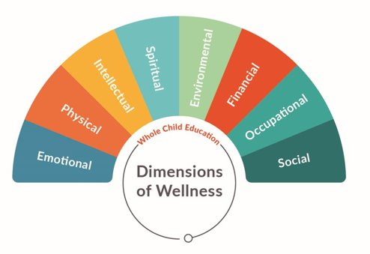
Real World Learning
Aprendizaje del Mundo Real

Slide 9
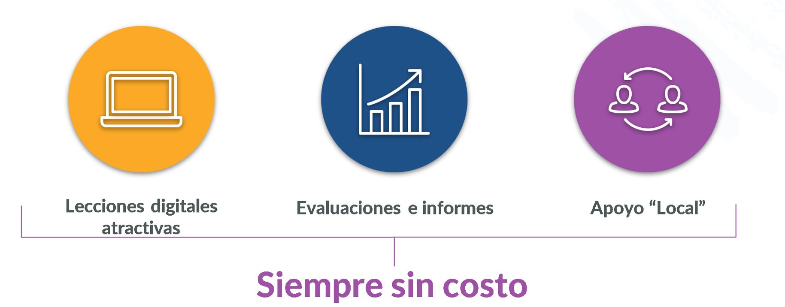
Your Partners in Whole Child Learning
Sus socios en el aprendizaje integral del estudiante

Slide 10
EVERFI's Impact in Puerto Rico 2022-2023
Impacto de EVERFI en Puerto Rico 2022-2023
24
2,421
10,461
Participating Schools
ESCUELAS
PARTICIPANTES
Student Using Everfi
ESTUDIANTES
USUARIOS DE EVERFI
Completed Lessons
LECCIONES COMPLETADAS
Socios + Patrocinio

Slide 11
Instructional Resources
Recursos de Instrucción

Slide 12
Educación Financiera | Preparación para la carrera laboral, ciencias, tecnología, ingeniería y matemáticas | Aprendizaje Socioemocional | Salud y Bienestar | Preparación Académica: Primaria | Aprendizaje de las Culturas
Vault Understanding Money Grados 4-6 | Future Goals Hockey Scholar Matemáticas Grado 4-7 | The Compassion Project: Lower Elementary Grados 2-3 | Healthier Me Nutrition & Wellness Grados 1-4 & Grados 6-8 | WORD Force A Literacy Adventure Grados K-2 | 306 African–American History Grados 8-12
FutureSmart Grados 6-8 | Future Goals Hockey Scholar Ciencia Grados 4-7 | The Compassion Project: Upper Elementary Grados 4-5 | Understanding Mental Wellness Grados 8-10 | Summer Slugger matemáticas & Literacy Grados 4-5 | 306 Continuing the Story Grados 8-12
SaveUp: Saving Money for the Future Grados 6-8 | Sustainability Foundations Grados 5-8 | Ignition Digital Wellness & Safety Grados 6-9 | AlcoholEdu Grados 9-12 | -- | BINAH: Building Insights to Navigate Antisemitism & Hate Grados 9-12
Venture Entrepreneurial Expedition Grados 7-10 | Plants, Animals, and Our World Grados 5-8 | Character Playbook: Healthy Relationships Grados 7-9 | Prescription Drug Safety Grados 9-12
EVERFI Financial Literacy Grados 9-12 | Ready to Recycle Grados 5-8 | Honor Code Bullying Prevention Grados 8-10 | Vaping: Know the truth Grados 8-12
Money Moves Modern Banking & Identity Protection® Grados 9-12 | Endeavor STEM Literacy & Career Exploration Grados 7-9 | Get Digital: Safety in the Metaverse Grados 8-12 | Healthcare Literacy: Making Healthy Choices Grados 9-12
Pathways Financing Higher Education Grados 9-12 | Keys To Your Future College & Career Grados 9-12 |  | Healthcare Literacy: Navigating Medical Care Grados 9-12 |  | Cursos Disponibles en español y francés
Marketplaces Investing Basics Grados 9-12 | Data Science Foundations Grados 9-12 |  |  |  | Cursos Disponibles en español
Build: Credit Fundamentals Grados 9-12 | Data Science Exploration: Banking Fraud Grados 9-12 |  |  |  | Cursos Disponibles en francés
Grow: Financial Planning for Life Grados 9-12 | Data Science Exploration: Financial Wellness Grados 9-12
Notes:
Optional slide to highlight courses available in English, Spanish & French

Slide 13
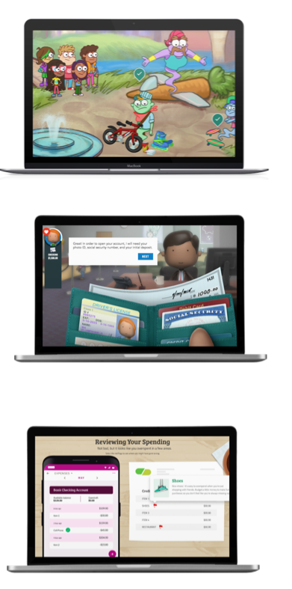
Financial Education At Every Stage
Educación
financiera
en
cada etapa 2
Vault:
Understanding Money
Grados 4-6
FutureSmart
Grados 6-8
EVERFI:
Financial Literacy
Grados 9-12

Slide 14
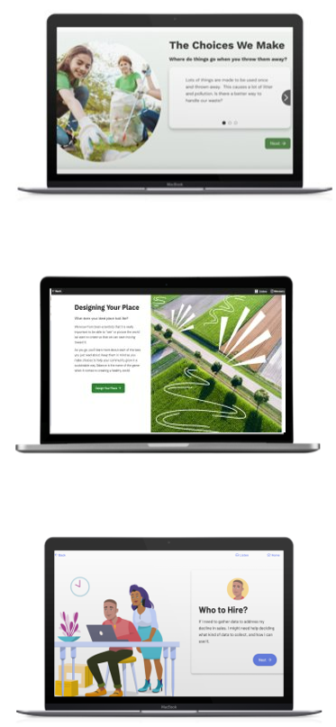
STEM
+
Career
Readiness
Preparación
Para la Carrera
Laboral y
Ciencias,
Tecnología,
Ingeniería y
Matemáticas
Sustainability Foundations: Ready to Recycle
Grados 5-8
Sustainability Foundations
Grados 5-8
Data Science Foundations
Grados 7-9

Slide 15
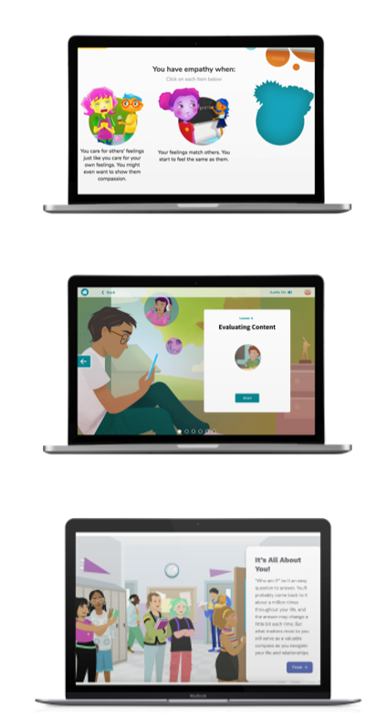
Social
Emotional
Learning
Aprendizaje
Socioemocional
The Compassion Project
Grados 2-4
Ignition:
Digital Wellness & Safety
Grados 6-9
Character Playbook
Grados 7-9

Slide 16
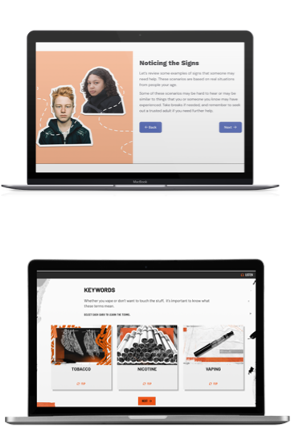
Understanding Mental Wellness
Grados 8-10
Health & Wellness
Salud
y
Bienestar
Vaping: Knowing the Truth
Grados 4-7

Slide 17
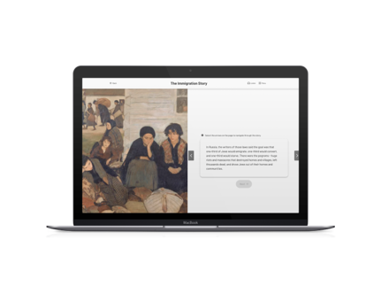
Cultural
Literacy
Aprendizaje de las
Culturas
BINAH: Building Insights to Navigate Antisemitism & Hate
Grados 9-12
306: Continuing the Story
Grados 8-12

Slide 18
Course Demo
Demostración del Curso

Slide 19
Lesson Breakdown
Estructura de la lección digital
New Learning
Reflection
Activity

Slide 20
Financial Capability
Deep Dive
Explorando la Capacidad Financiera con Everfi

Slide 21
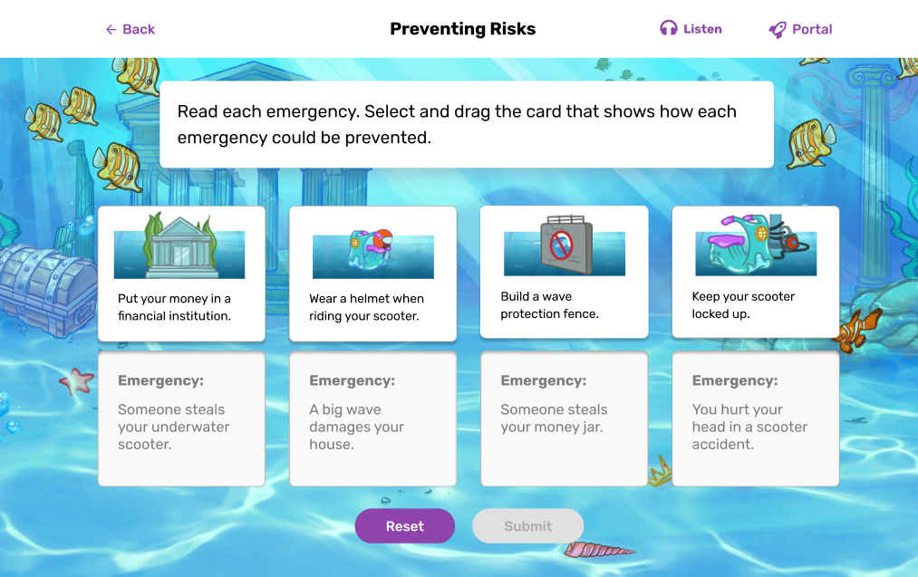
Vault: Understanding Money
Vault:
Understanding Money
At-a-Glance
Vault: Understanding Money is a digital education program that teaches students how to make wise financial decisions and improve their socio-emotional skills. The interactive lessons will engage learners in an immersive adventure that translates financial concepts into easy to apply experiences that help students develop strategies for managing future finances.
Course Highlights
Immersive and diverse environments and characters
Learning through problem solving
Self-reflection and games that provide additional practice
Course Topics
Financial Decision Making
Budgeting and Spending
Income and Careers
Credit and Borrowing
Future Planning
Also Available in French and Spanish
Grade Level: 4th -6th
Total Lessons: 5 lessons, about 15 min each
Standard Alignment: Jump$tart National Standards, CEE National Standards for Financial Literacy, and State-Based Financial Literacy Standards, and CASEL SEL framework
Suggested Class Fit: Economics, Math, Guidance, CTE
Notes:
Teacher Quote - [Vault] introduced the students to real expectations. It made them really have to think about money and how far it goes (and what they should do with it). Licking R-VIII, MO
Student Quote - I learned many important skills in the EVERFI course I took, but I believe that the most important ones were savings, budgeting, and learning what careers may be best for me in my future. Learning to save money has to be one of the most important skills you can learn at my age because it ensures that you will be set for the future. Our Lady of Lourdes Interparish School, MO
+intro/outro
The CFPB Building Blocks to Help Youth Achieve Financial Capability
21 Century Skills

Slide 22
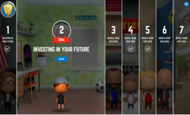
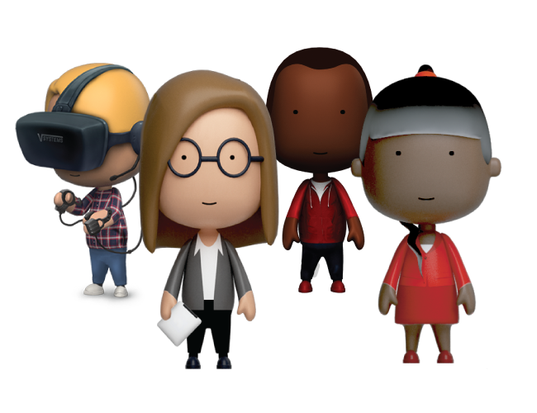
FutureSmart
FutureSmart
At-a-Glance
Through a compelling storyline in which students become the Mayor of a fictional town, they are faced with the real-life financial decisions and obstacles of their citizens. By helping their citizens with everything from budgeting for some bedroom decorations to guiding someone through the college financial aid process, students build important skills that help them to become FutureSmart.
Course Highlights
Simulation-based learning embedded with real-world decisions
Companion mobile app to reinforce positive financial decisions
Customizable and printable blueprint for their financial future
Course Topics
Financial values and goal-setting
Budgeting and opportunity costs
Saving and investing
Risk vs. return
Grade Level: 6th -8th
Total Lessons: 7 lessons, 20-25 minutes each
Standard Alignment: State and national Jump$tart, NCSS
Suggested Class Fit: Career Readiness, Social Studies, FACs, Guidance
Also Available in Spanish
Through a recent study, researchers found that middle school students who took FutureSmart increased their financial knowledge by 19% more than a control group of their peers, regardless of student demographics.
Notes:
https://futuresmart.massmutual.com/en/scholarship/
Teacher Quote - [Futuresmart] helps students to learn concepts that have never been introduced in a short span and with meaningful real world application. NJ
Student Quote - NA
Slides about FutureSmart Finlit resources for families and for educators
Research Study - https://donahue.umass.edu/our-publications/impact-of-the-futuresmart-online-financial-education-course-on-financial-knowledge-of-middle-school-students

Slide 23
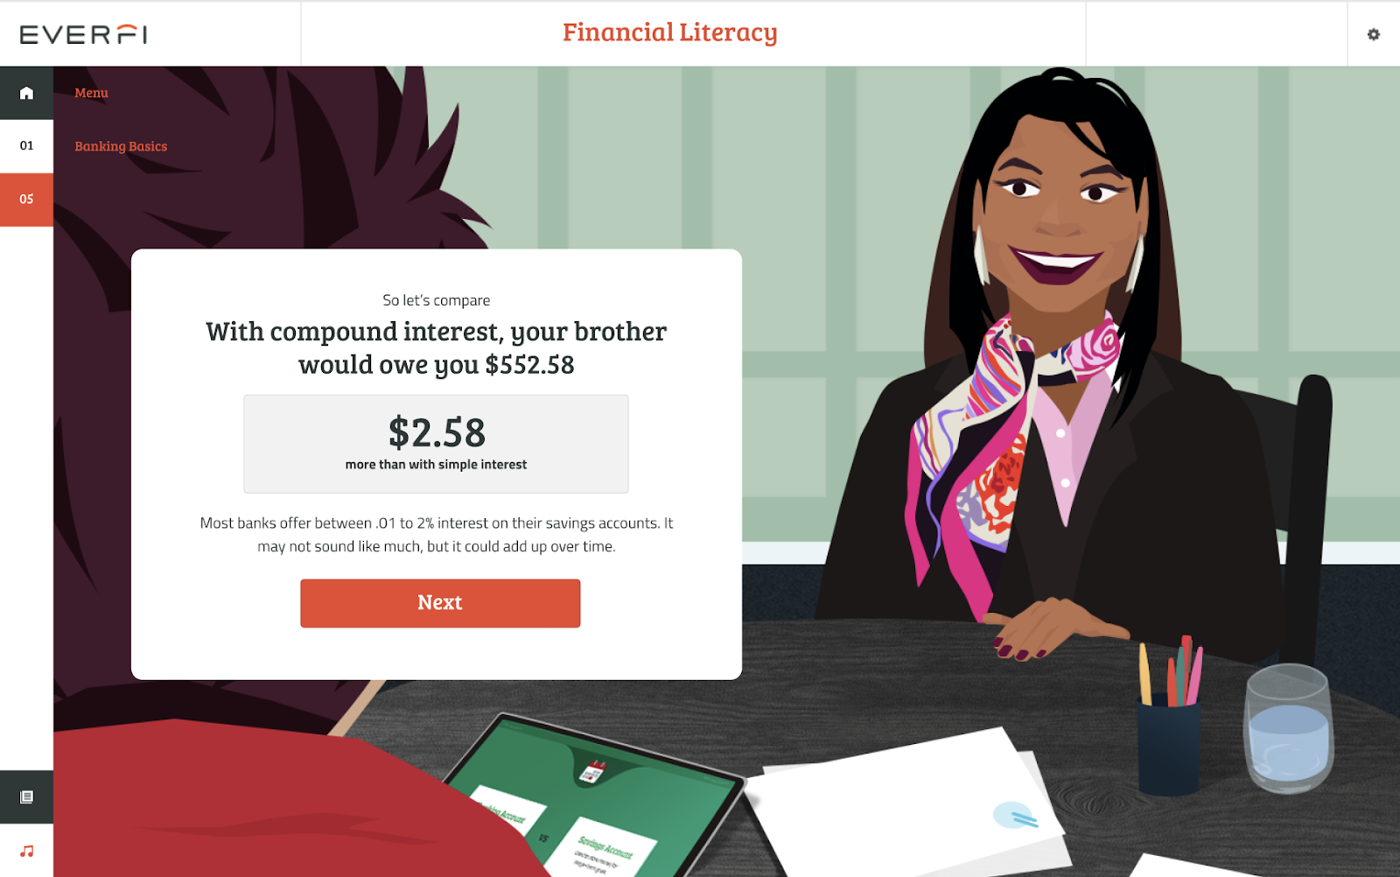
EVERFI Financial Literacy
EVERFI
Financial Literacy
At-a-Glance
EVERFI: Financial Literacy is a digital education program that teaches students how to make wise financial decisions to promote financial well-being over their lifetime. The interactive lessons will translate complex financial concepts and help students develop actionable strategies for managing their finances.
Course Highlights
Immersive and diverse environments and characters
Learning through problem solving
Modern, relevant content
Self-reflection and games that provide additional practice
Course Topics
Banking Basics
Employment & Taxes
Budgeting
Consumer Skills
Managing Credit and Debt
Financing Higher Education
Insurance
Also Available in Spanish
Grade Level: 9th -12th
Total Lessons: 7 lessons, about 20-30 min each
Standard Alignment: Jump$tart National Standards, CEE National Standards for Financial Literacy, and State-Based Financial Literacy Standards
Suggested Class Fit: Finance, Economics, CTE, Social Studies, Business
Notes:
Teacher Quote - The EVERFI Financial Program is the one tool I see the students using to gain independence in learning and thinking. They have to listen to the tutorial to understand the material, and they have to question the material if they don't understand. All the information on the tutorials helped teach and reteach the students about the many areas of Personal Finance. Benzie County Central Schools, MI
Student Quote - The Financial Literacy course helped me learn skills in the classroom that directly connect to demands in real life. These skills were both relevant to myself and to the rest of the class, as they are early preparation for habits that will be necessary for success later on. It also helped me to have less anxiety about the future; I definitely feel more prepared for independent life now. Lafayette Big Picture High School, NY

Slide 24
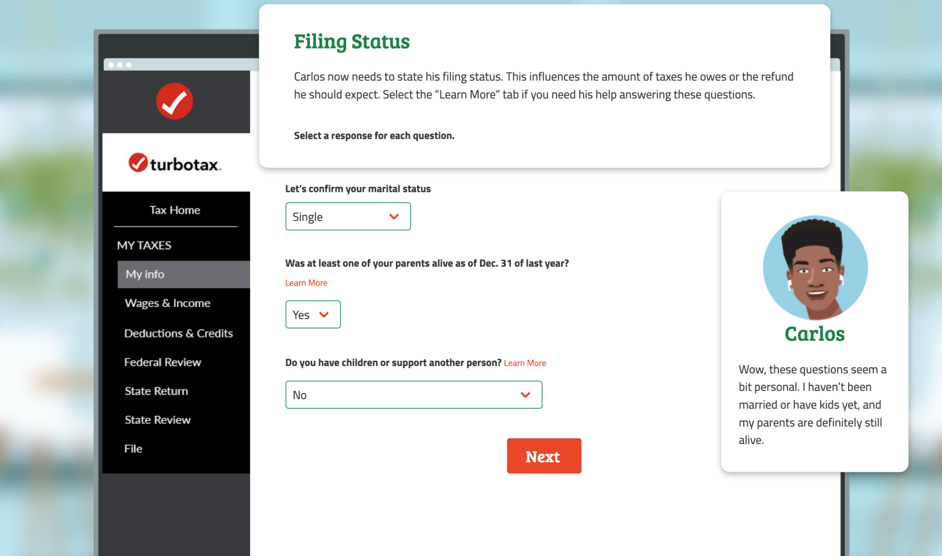
At-a-Glance
The TurboTax simulations exist within EVERFI: Financial Literacy and are dedicated to providing high school students with the skills and knowledge they need to fill out their taxes using common tax preparation software. This includes federal and state taxes along with special tax situations such as education credits and gig economy work.
Course Highlights
Scenario-based narrative
Immersive and diverse environments and characters
Learning through problem solving
Higher order thinking skills
Course Topics
Tax Preparation Software
Tax Credits for Families
Taxes for Gig Workers
Taxes for Students
Taxes for Investments
TurboTax Simulations
within FinLit
Grade Level: 9th -12th
Total Lessons: 5 lessons
Total Length: 45 mins
Subject Alignment: Financial Literacy, CTE, Math
Languages: English, Spanish (future release)

Slide 25
EVERFI Access for Teachers
Acceso a EVERFI para Profesores y Maestras/os

Slide 26
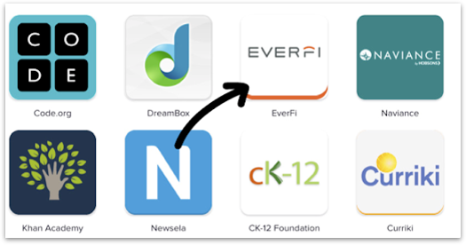
SSO Teacher Registration
Registro de maestros para Clever
Vaya a la pantalla de la computadora y encuentre la aplicación Clever
Haga clic en la aplicación Clever
Inicie sesión con las credenciales del DOEPR
Haga clic en la aplicación EVERFI para comenzar

Slide 27
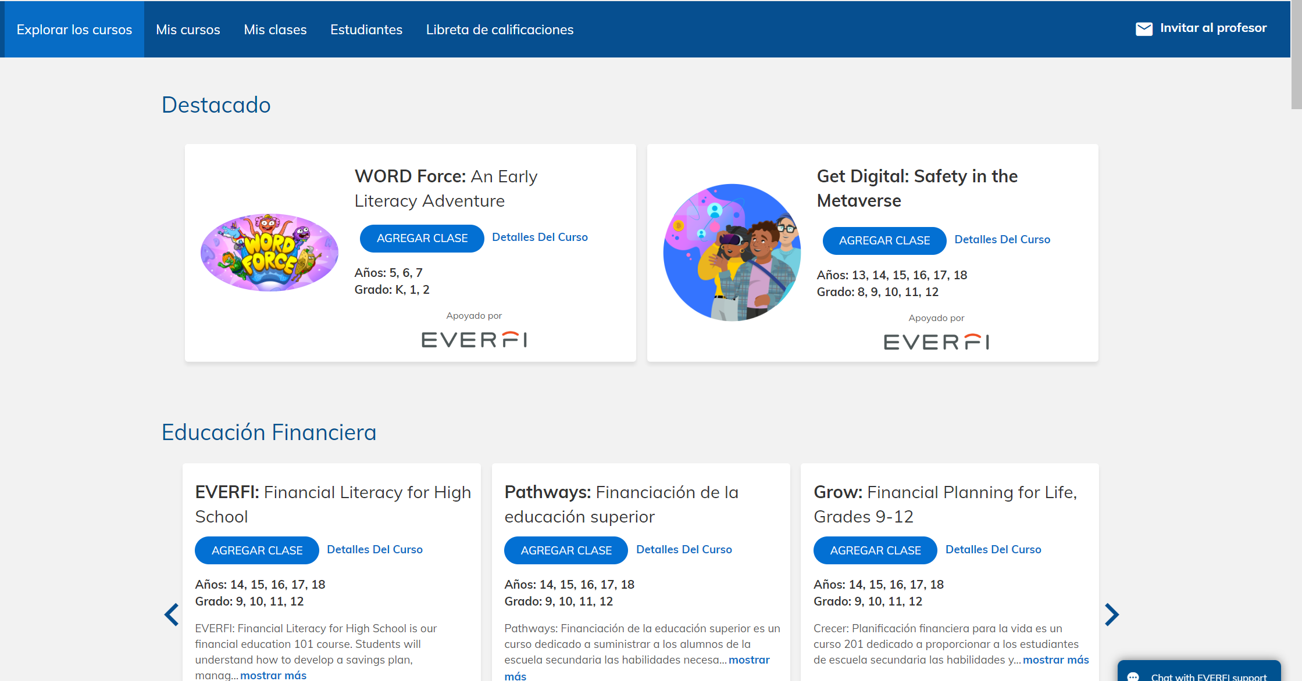
Explore Courses
Explorar los Cursos

Slide 28
Creating Classes
Crear una Clase

Slide 29
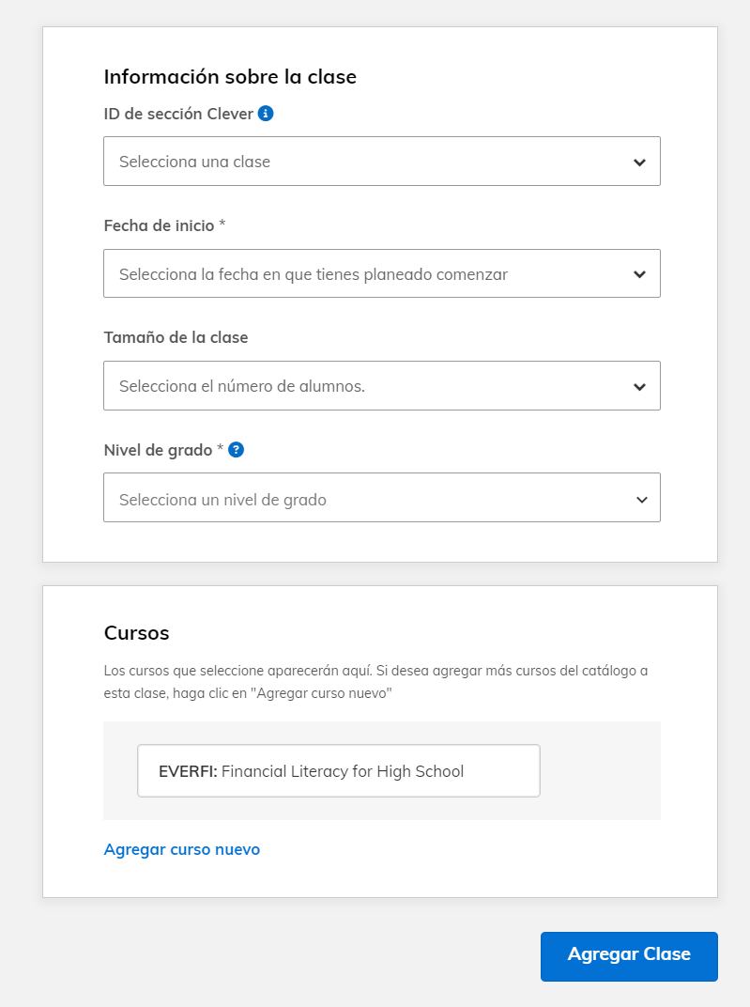
Creating Classes
Creación de Clases
Seleccione el curso que está sincronizado desde Clever
Seleccione fecha de inicio
Seleccione el nivel de grado
* Ingresar el tamaño de la clase es opcional
Seleccione Agregar clase

Slide 30
Gradebook
Liberta de Calificaciones

Slide 31
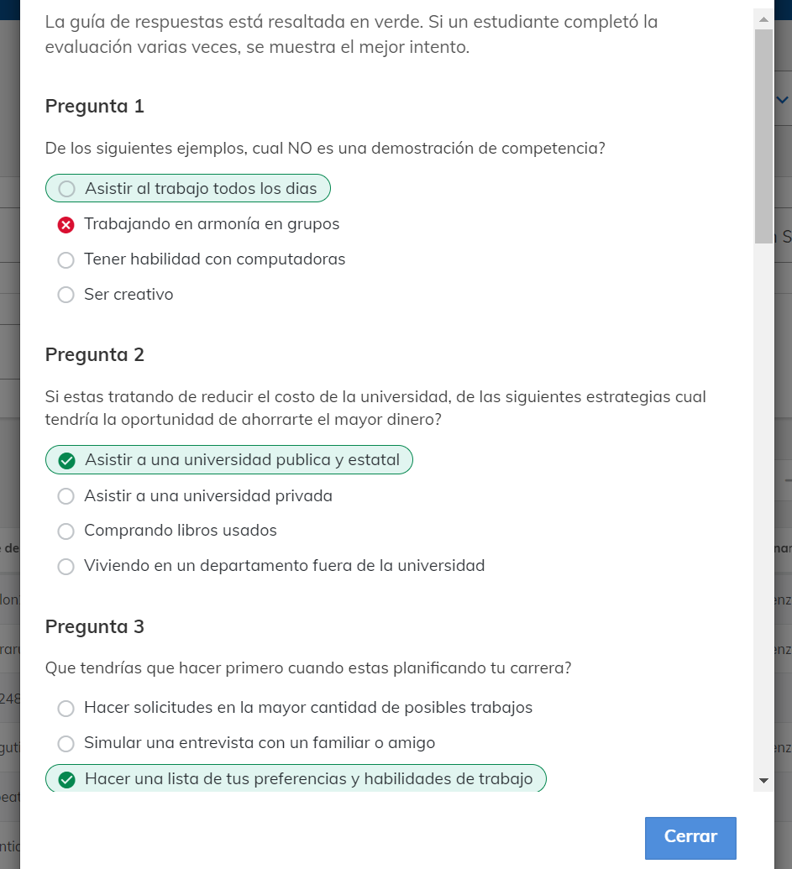
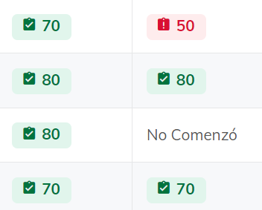
Gradebook
Liberta de Calificaciones

Slide 32
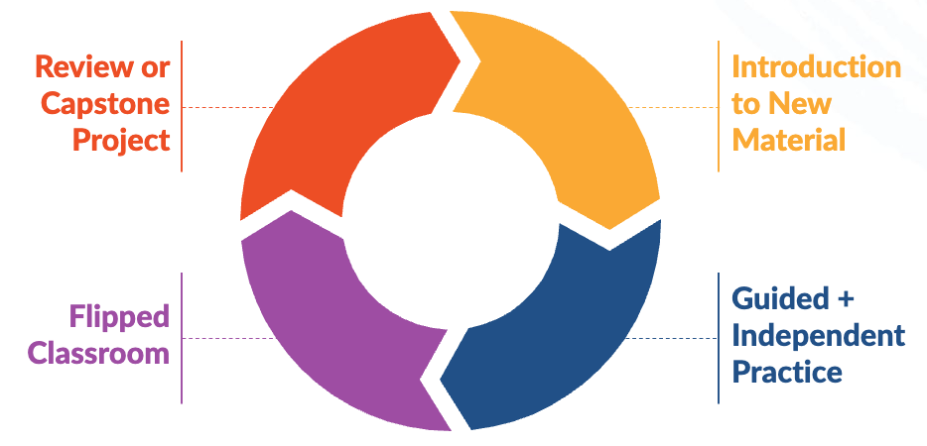
Implementation Strategies

Slide 33
EVERFI Access for Students
Acceso EVERFI para
Estudiantes

Slide 34
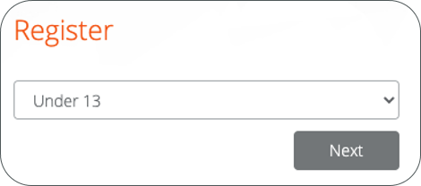
Clever Student Login Instructions
Instrucciones de inicio de sesión de Clever para estudiantes
Ir al portal del distrito
Haga clic en la aplicación Clever
Haga clic en la aplicación EVERFI
Bajo Recursos Educativos/Académicos
En la página Registrarse, seleccione rango de edad y Siguiente
Menores de 13, 13-18 o mayores de 18
Haga clic en Inicio
Trabajar a través de las lecciones de forma independiente

Slide 35
Select Preferred Language
Selección del Idioma Preferido
Students can change the preferred language to Spanish on their Dashboard.
Estudiantes tendrán que cambiar el idioma preferido a español en su tablero

Slide 36
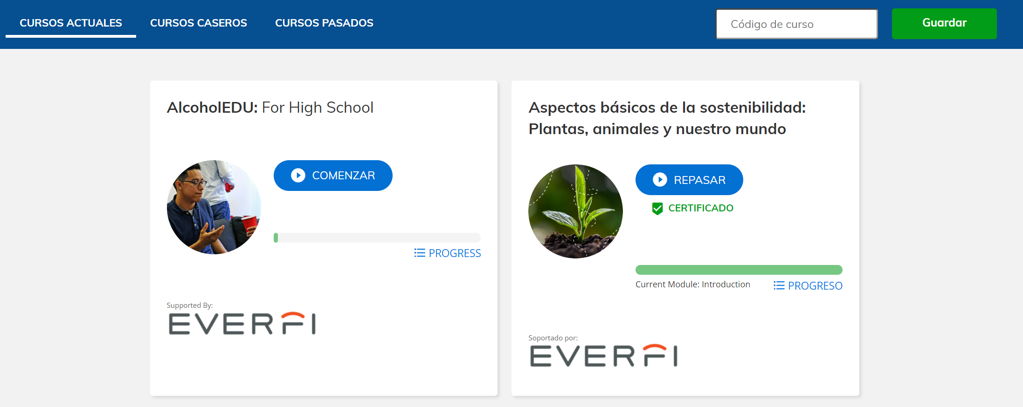
Student Dashboard
Panel del Estudiante

Slide 37
Moving Forward
Próximos Pasos

Slide 38
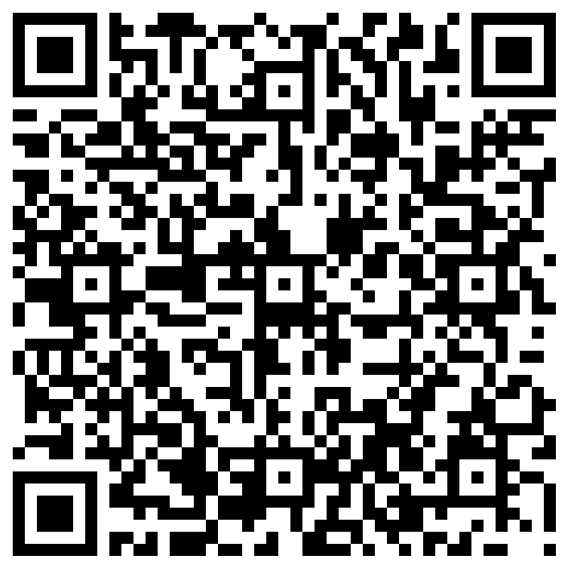

Slide 39
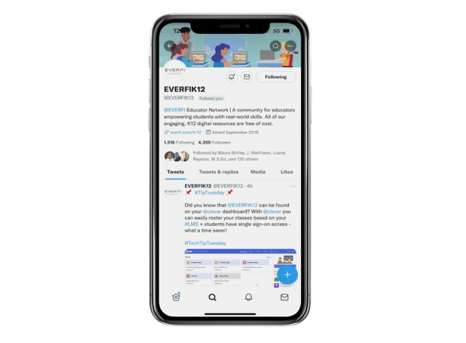
Join Our Social Media Community
Únase a Nuestra Comunidad de Redes Sociales
@EVERFIK12

